Slide 1
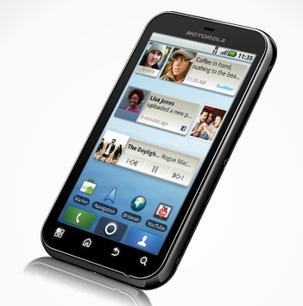

MOBILE ELECTRONIC PROGRAM GUIDE
Under the Guidance of DIVAKARA.N . Asst. Professor
BY:
ABHISHEK.R [4JC09CS004]
BHARATH.S.N [4JC09CS014]
GAURAV.G.MANUR [4JC09CS030]
PHANI PAWAN.P [4JC09CS066]

Slide 2
MOBILE ELECTRONIC PROGRAM GUIDE
MEPG provide users of television with continuously updated menus, displaying scheduling information for current and upcoming programs.
MEPG allows the viewer to take advantage of features such as program summaries, search by show/program, immediate access to the selected program and reminder.

Slide 3

Plugging MEPG into mobile as an application.
MEPG helps user to get TV schedules on the mobile phone with just a single click.
Why ????
How ????

Slide 4
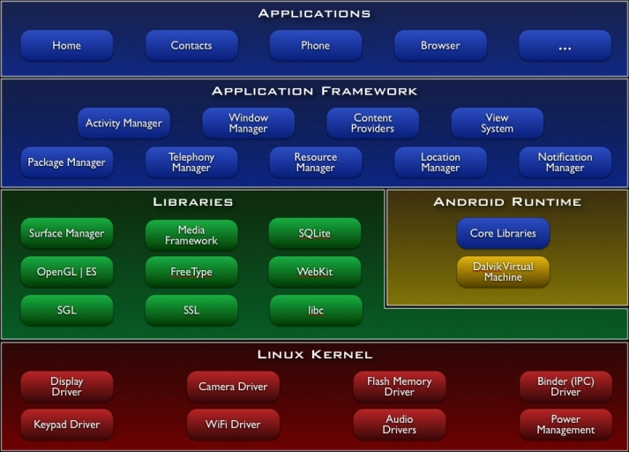
Android Architecture

Slide 5
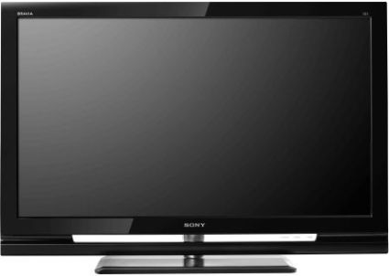


Existing System
No such mobile application exists till date.
Some of the trivial approaches are:
TV Early Updates
Newspaper
Ask a friend

Slide 6
Proposed System And Features
Services offered by the application are :
Channel List based on language
To View the Schedule of shows of particular channel
What’s playing now ?
Search for a particular show/ channel
Add reminders for particular shows
Get the favorites list

Slide 7

Aim
Objective : to provide personalized access to TV Listings directly on mobile phone.
Building a mobile app with exiting features
Adding reminders
Searching for a show
Adding favorites
Mobile application with Alerts and notifications

Slide 8
Tools
Hardware Tools:
Mobile which has below features
(i) GPRS
(ii) Android OS
Software Tools:
Android SDK 1.5 or above.
Eclipse IDE
PHP
MySQL Server

Slide 9
Interfaces
There are 2 phases
I) End user interface (client side)
(i) Main Menu
->Channel list
->What’s playing now
->Search
->Favorites

Slide 10

Contd....
II) Admin interface(Server side)
(i) Administration login
(ii) Menu

Slide 11

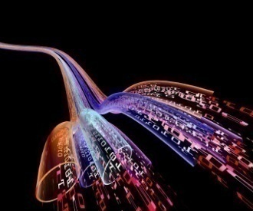
System Design
Architectural Design
Data Flow Diagram

Slide 12
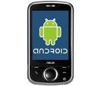
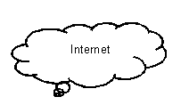



Architecture
Server Side
Client Side

Slide 13

Client side
ANDROID APPLICATION
RUNNING IN MOBILE
MOBILE PHONE
UPON CLICKING
CHOOSE THE LANGUAGE
>ENGLISH
>HINDI
>KANNADA….
LIST OF CHANNELS
ON CHOOSING
THE CHANNEL
UPON CHOOSING
THE LANGUAGE
PROGRAM LIST
DATES

Slide 14


Server side
Database
Database
Web Service
Admin Portal
Server

Slide 15


Modules
Entire system consist of two components
Mobile component [ Client Side ]
Server component

Slide 16

Mobile component
The mobile component has below modules
GET CHANNEL LIST
GET SHOW DETAILS
WHAT’S PLAYING NOW
SEARCH
FAVORITE LIST

Slide 17
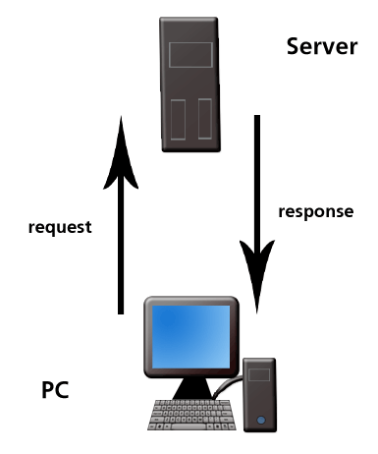
Server component
WEB Service
Functions of the web service are
(i) Authentication and authorization.
(ii) Sending Channel List to device
(iii) Sending Shows list to device.
(iv) Sending Searching data to device.
(v) Sending What playing now data to device and etc.,
PHP admin portal
Functions of the portal are
(i) Authentication and authorization
(ii) Adding new channels and its related data.
(iii)Adding Shows list and its related data.
SQL Server Database

Slide 18



Implementation
Technologies used
Platform
Android OS
Languages
Php
Java
IDE
Eclipse IDE
Database
MySQL
Database

Slide 19

Flow Charts Of Modules
Admin Login
Add Channels
Add Shows

Slide 20
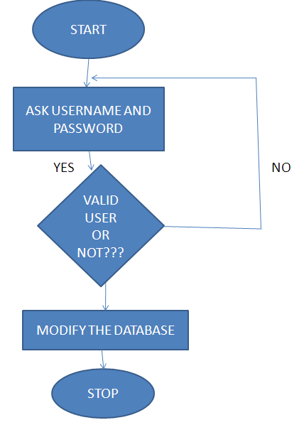
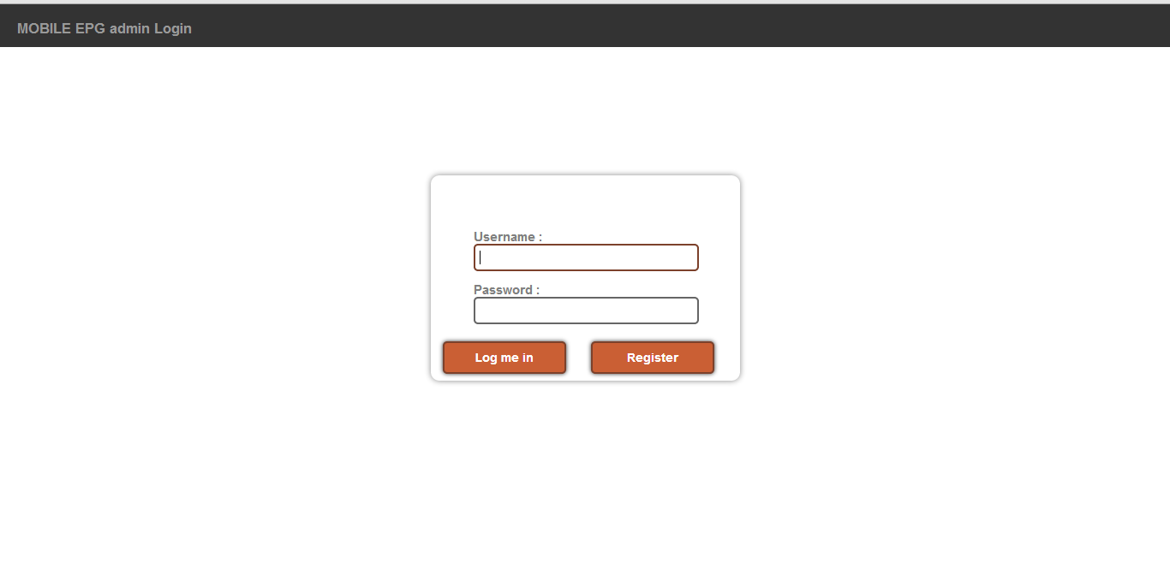
Admin Login

Slide 21
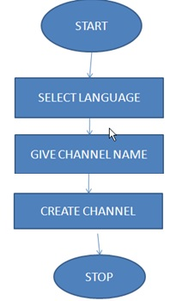
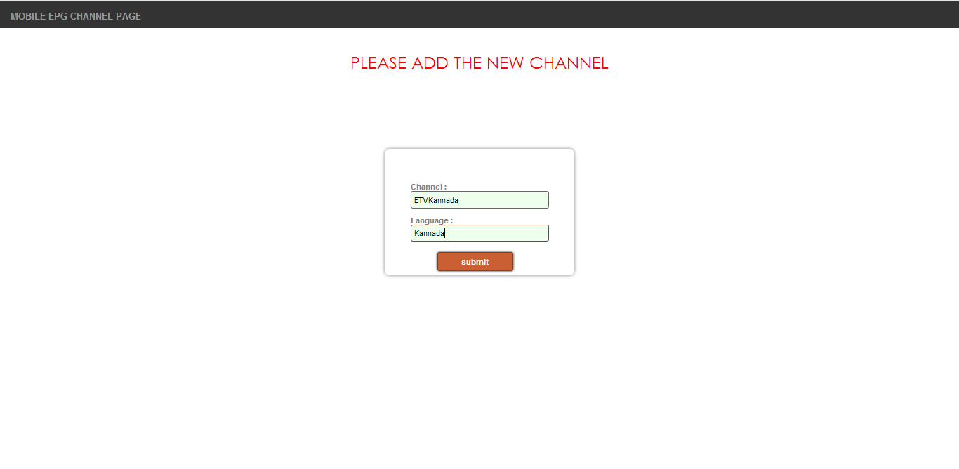
Add Channels

Slide 22
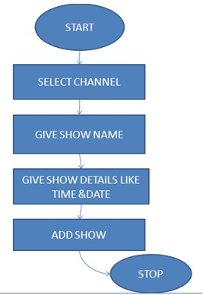
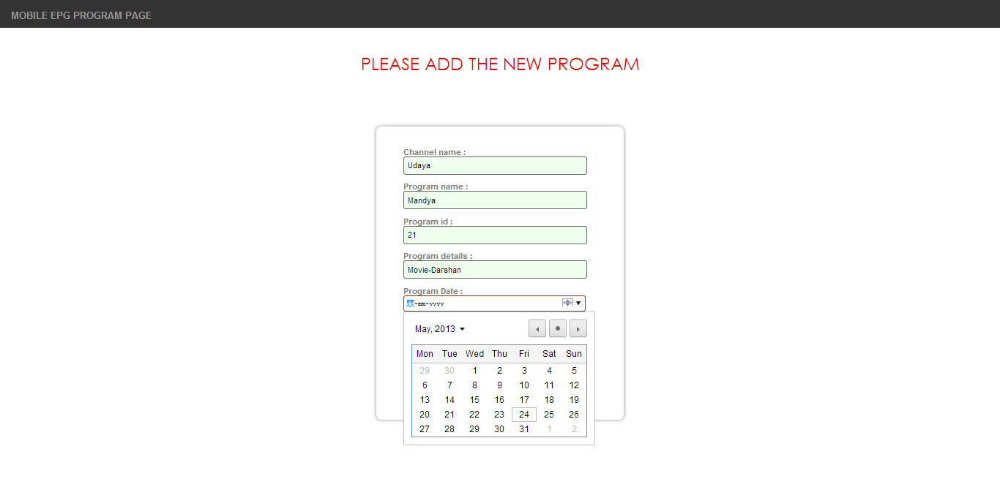
Add Shows

Slide 23
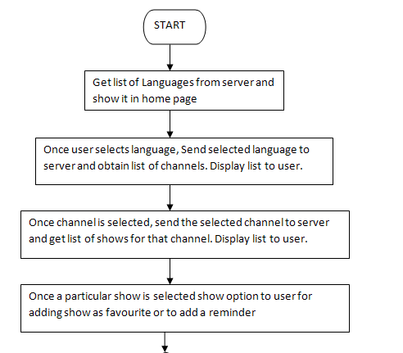

Data Flow Diagram
A

Slide 24
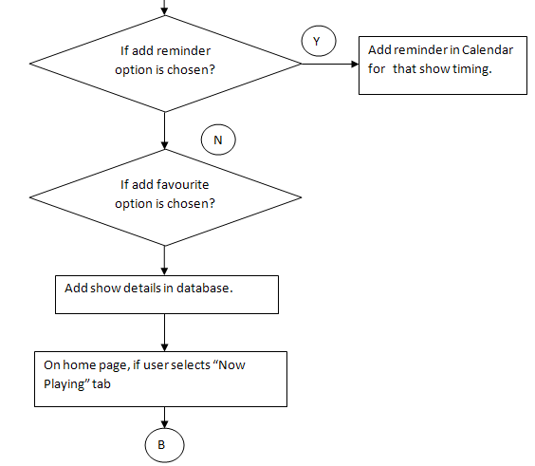
Contd….
A

Slide 25
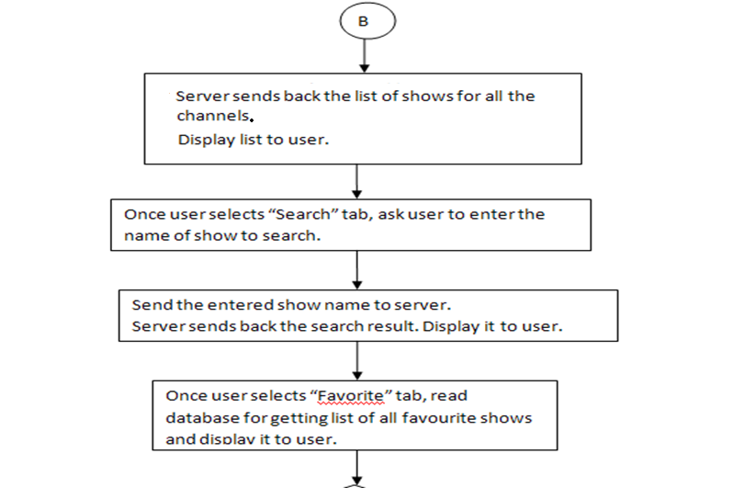
Contd….
B

Slide 26
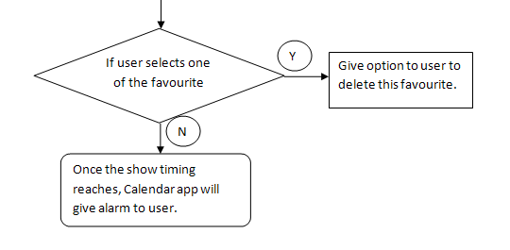
Contd…
B

Slide 27
Implementation

Slide 28
Conclusion
MEPG is a “real time” application.
MEPG is a simple , yet powerful application .
MEPG would be a challenge to the media today.

Slide 29
Future Enhancements
Live Streaming of the required programs.
To improve scalability of the application.
We wish to provide the users with particular videos related to their particular favorite programs.

